Slide 1
Digital Onboarding:
Introduction to Cocotb
NU Silicon

Slide 2
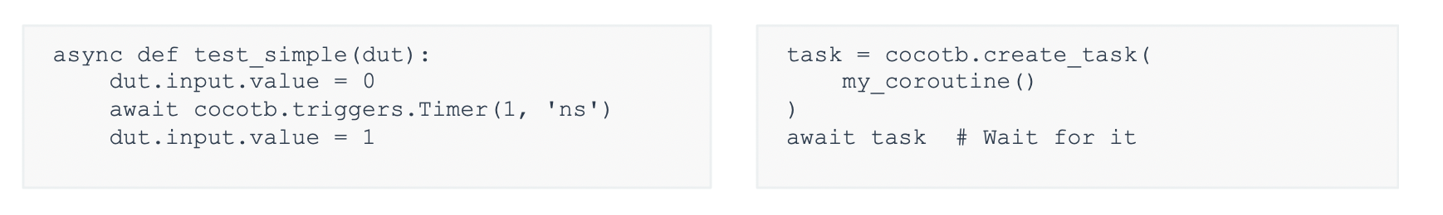
Cocotb
Cocotb: coroutine-based cosimulation testbench environment
Verification with Python – allows access to Python libraries for flexibility and scaling
Also needs a simulator (we will use ModelSim)
Coroutine: A Python async function that can yield control
Task: A running instance of a coroutine

Slide 3
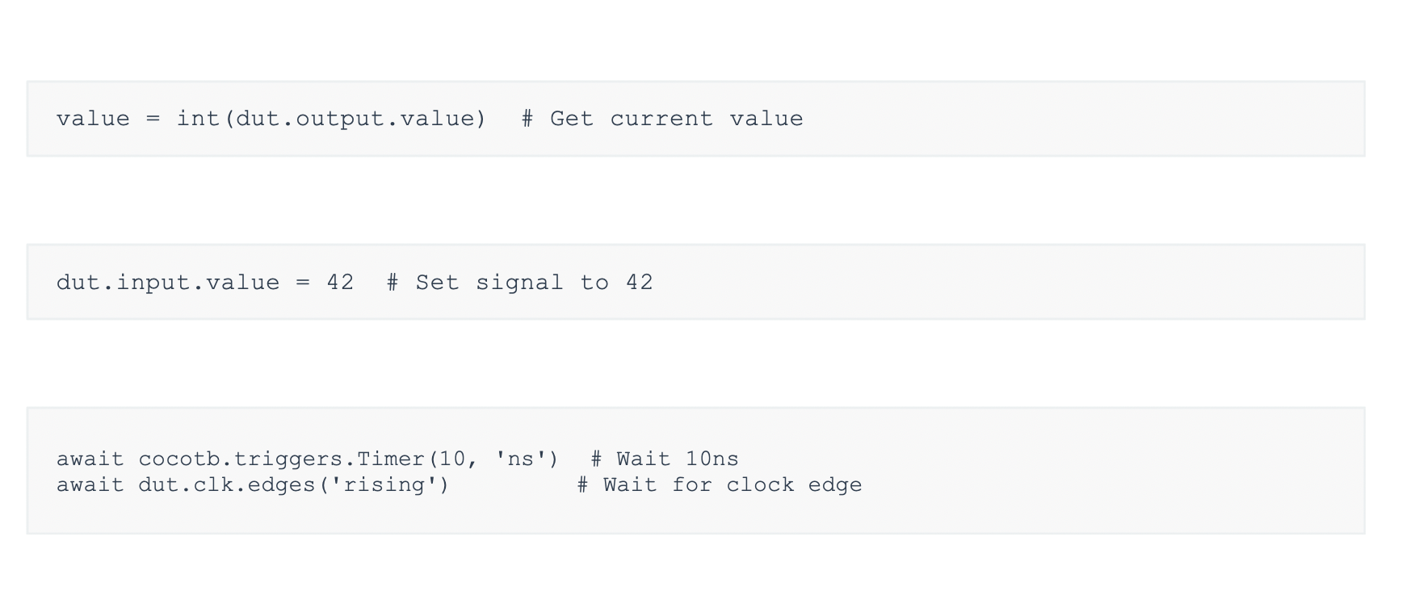
Cocotb
Reading a signal value:
Writing a signal value:
Waiting for events:

Slide 4
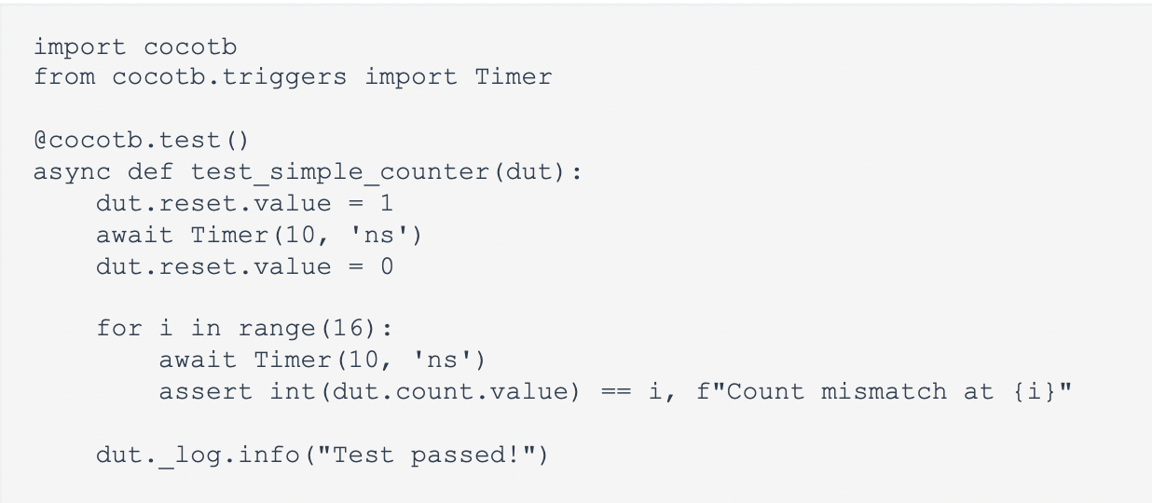
Cocotb Test Example

Slide 5
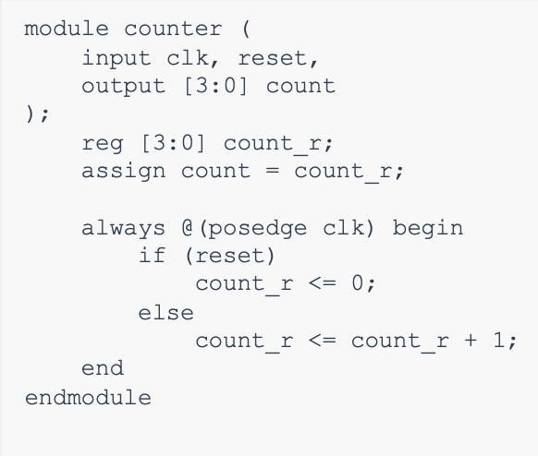
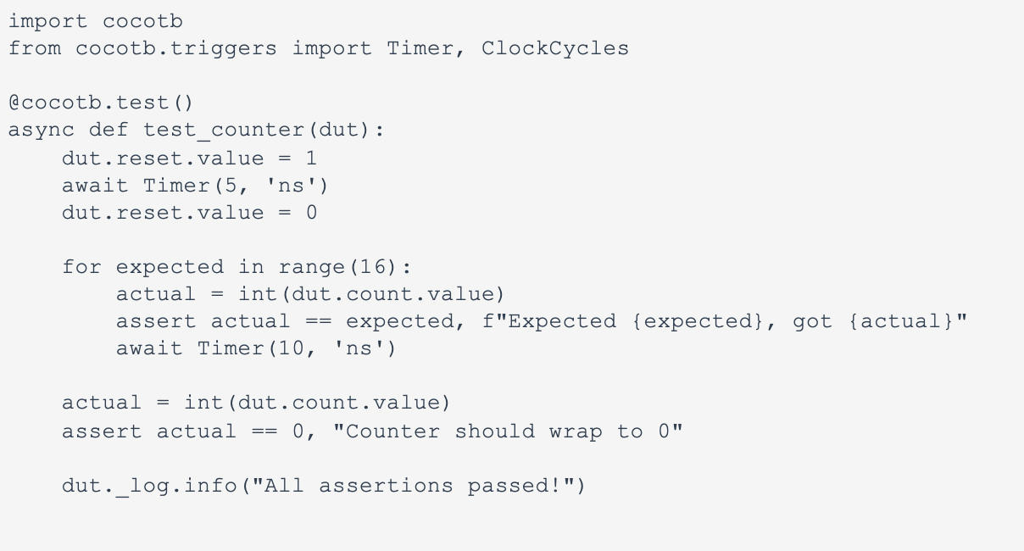
Cocotb Test Example
4 bit counter Asynchronous reset
Increments on clock edge Output wraps at 15

Slide 6
Note: The following slides are for using cocotb with UVM style verification and are mostly for reference. It gets complicated and might take some time to fully understand these concepts.
run pip install cocotb-uvm

Slide 7
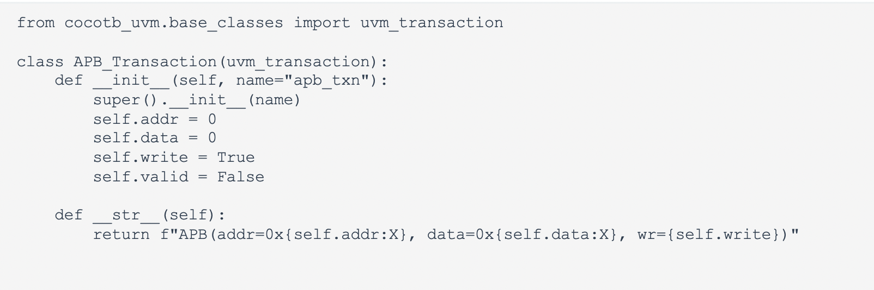
Transactions
Data objects that move through the design

Slide 8
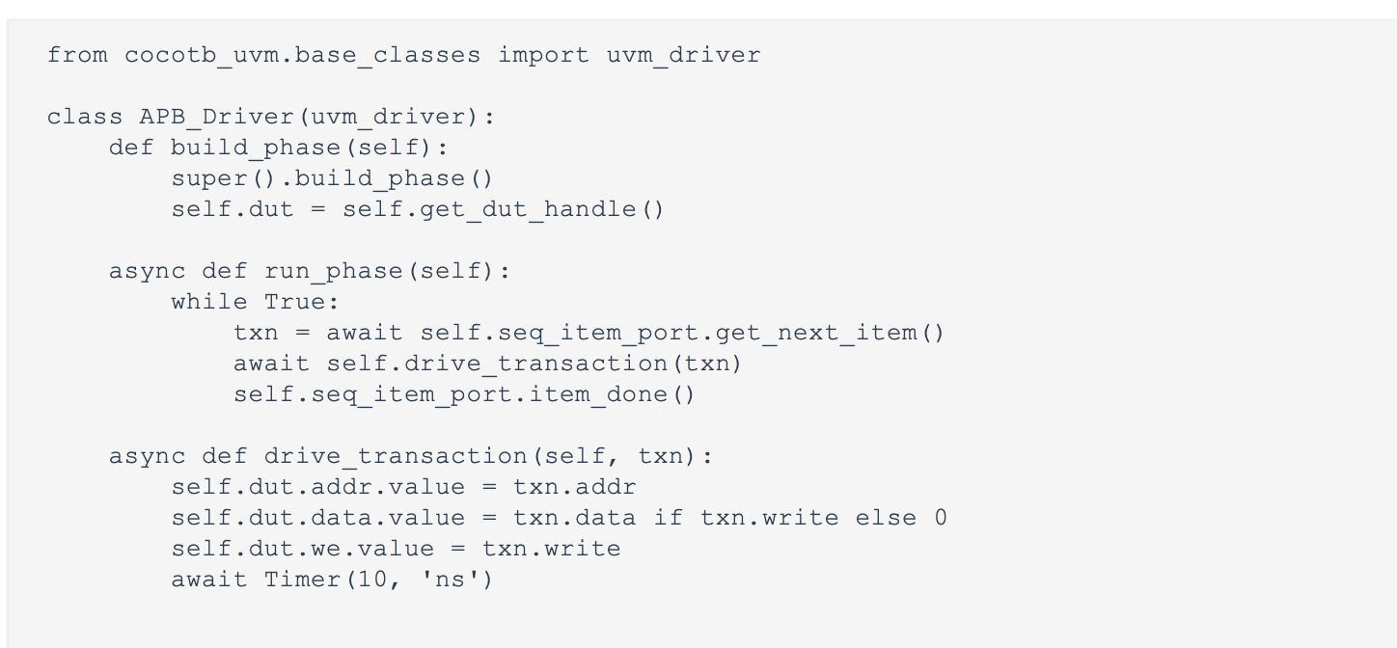
Drivers
Drivers convert transactions into actual signal toggles on the DUT

Slide 9
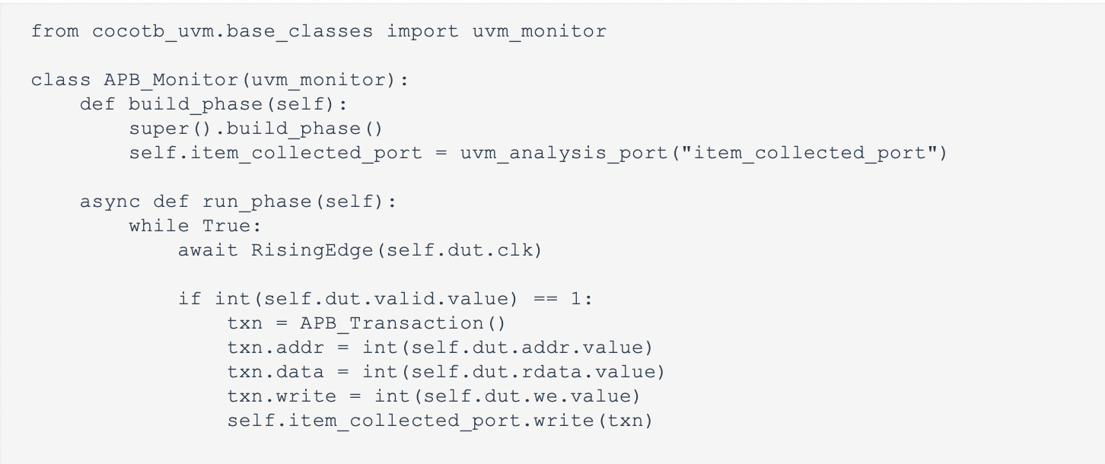
Monitors
Monitors observe DUT signals and create transactions

Slide 10
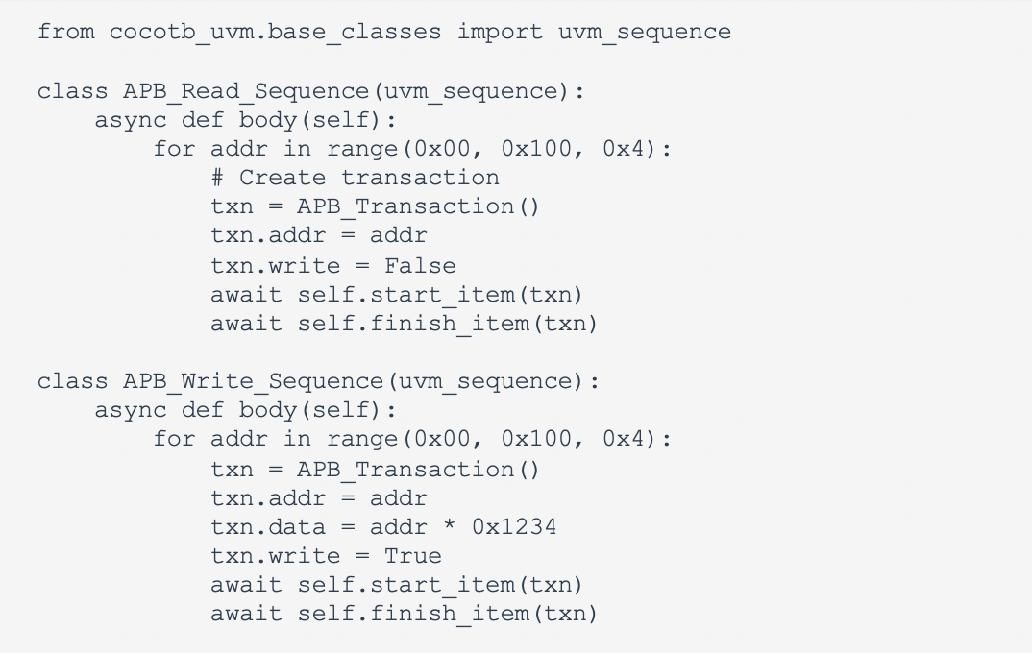
Stimulus (sequences or sequence items)
This is what drives the DUT

Slide 11
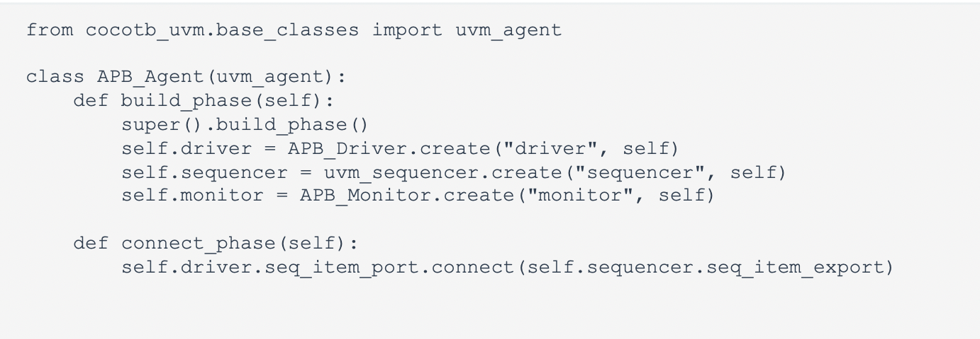
Agents (bundling what we have so far)

Slide 12
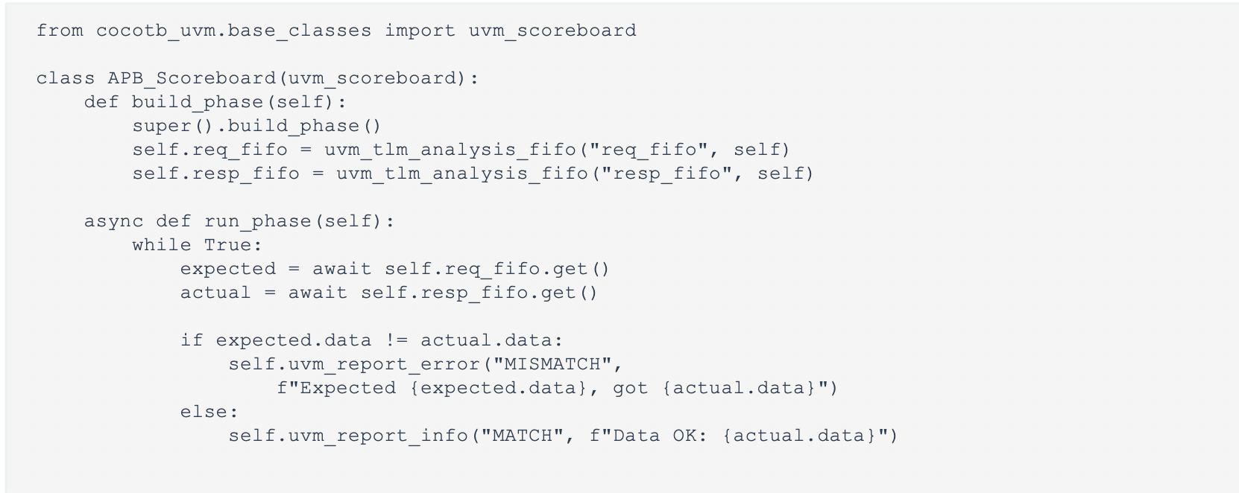
Scoreboards
Verify correctness by comparing predicted vs actual results. With more complex problems, python is a great language to simulate and create the expected results you want.

Slide 13
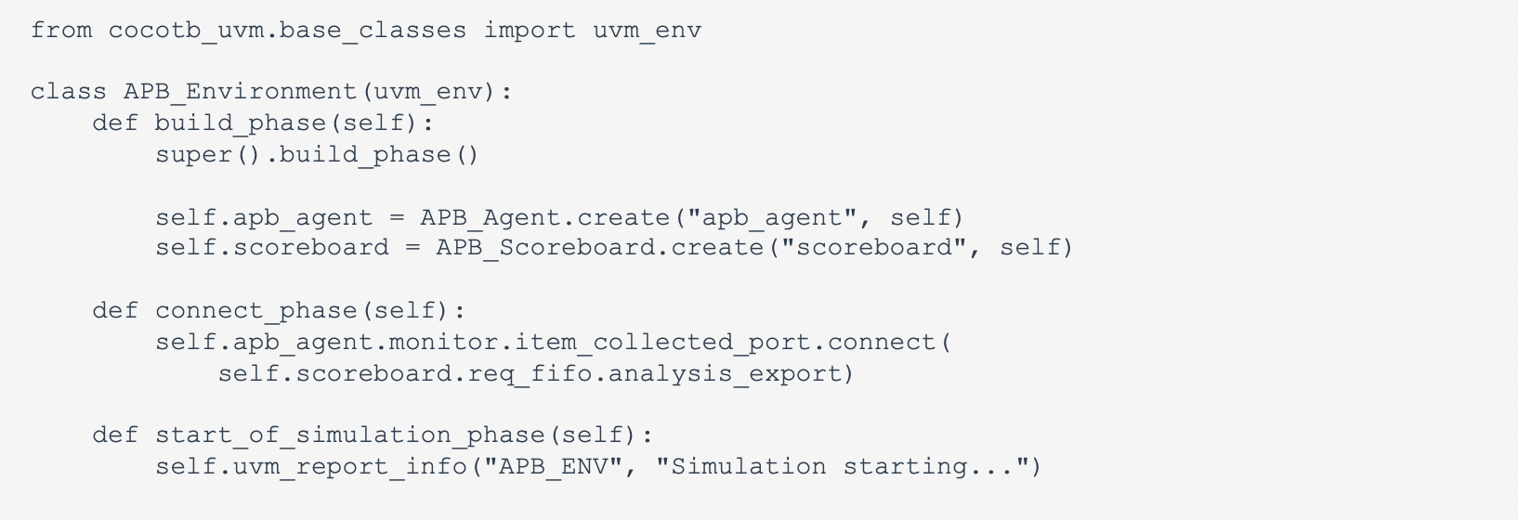
Environment

Slide 14
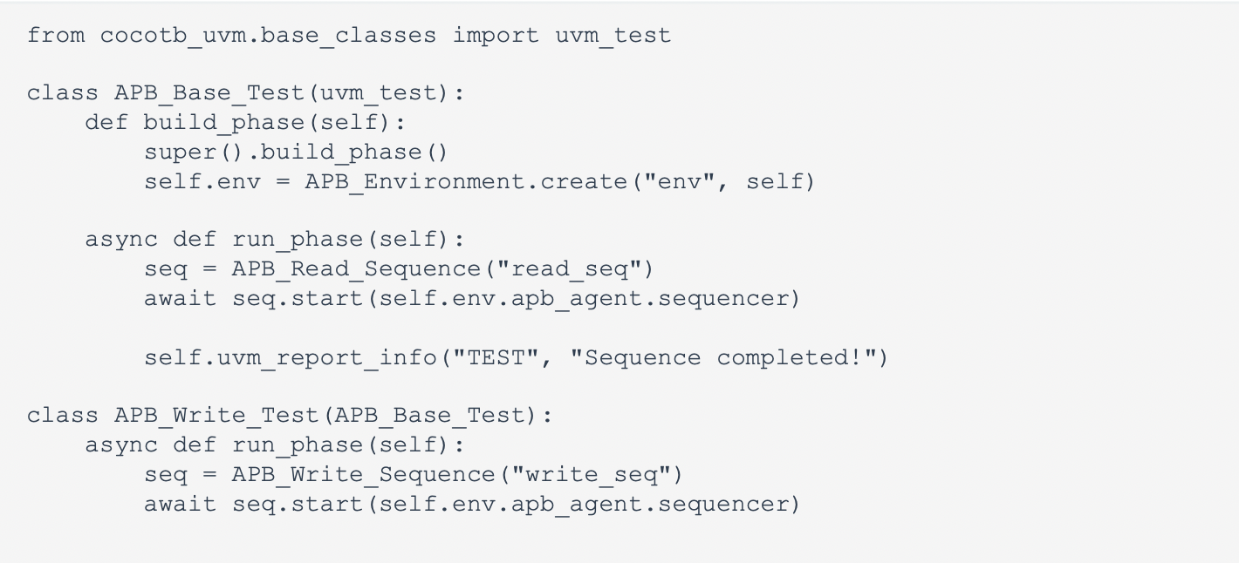
Tests
Configure and run sequences

Slide 15
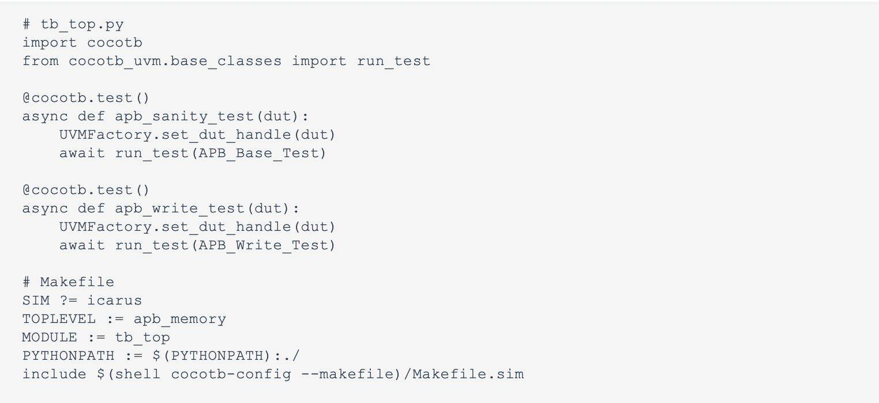
Putting it all together
Customize the makefile to your specifics

Slide 16
The End

